Slide 1
MATLAB Project
Project Title : Detecting parasitic infections with MATLAB
Name : Shreya Prabhu, Nisha S, Bhargavi G, Aiswarya R
SRN : PES1201800128, PES1201801777, PES1201800211,
PES1201800309

Slide 2
Introduction
Detection and Quantification of Babesiosis infection in Red Blood Cells
Babesiosis is a malaria-like, tick-borne parasitic disease caused by infection with the eukaryotic parasite Babesia.
We can easily observe the parasite in a blood cells.
In this project we develop functions to detect the presence of the Babesia parasite in blood smears, and to quantify the portion of cells that are infected.

Slide 3
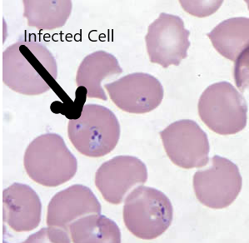
Our program gives an estimate of
number of infected cells in the sample
image

Slide 4
Motivation
The motivation for doing this project was primarily an interest in undertaking a challenging project in an interesting area of research.
The opportunity to learn about new topics not covered in lectures was appealing.

Slide 5
Methodology
Image Processing will be carried out using MATLAB. Input consists of heterogeneous microscopic blood-smeared images.
Segmentation:
We have two approaches :
1] Creating Binary Mask
Segmentation creates a binary mask that’s true wherever the region of interest (cells) is true and false otherwise(background).

Slide 6
Steps involved:
Converting image to grayscale
Create Cell Mask with segmenter app
Create edge mask, which is filtered
Finally combining the two where the non regions of interest are negated.

Slide 7
2 ] Watershed Segmentation: To solve the problem of contiguous regions
Image is treated as a topography. We assume the intensity values as heights above a particular pixel value rather than the brightness.
Edges of the cell have greater intensity. imhim species a threshold value and supresses all the minima whose height is less than this threshold value

Slide 8
Matrix of the imhmin suppressed image is used to manipulate the matrix of the masked image(image obtained after segmentation) to get watershed lines on the masked image.
Now we impose the watershed lines on our segmented image we specify wherever watershed is true , the cell mask of that area is zero .

Slide 9
Circle detection
imfindcircles() is used to find circles.
viscircles draws circles
detectCircles function- applied to all the images to encircle each cell.

Slide 10
Calculating the number of infected cells
Imhistmatch() addresses heterogenity in data by adjusting the histogram of the image to match that of reference.
Location of the centers of the circles(RBC’s) and the radii are used to create a custom mask of each one of the regions.We mask the regions that are part of the circle by finding out the hypotenuse of the triangle formed by the distance of the x coordinate of the point from the center of the circle and distance of y coordinate from center.If this distance is lesser than the radius of the circle, it lies in proximity to the infection.
We can identify infected cells each of the masks, values can be found where infection is less than or equal to the infection threshold.

Slide 11
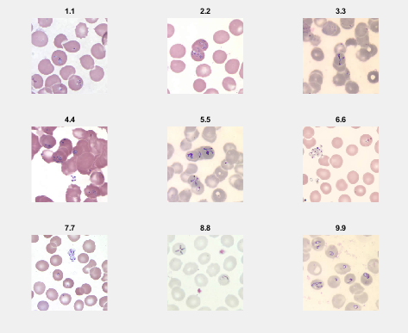
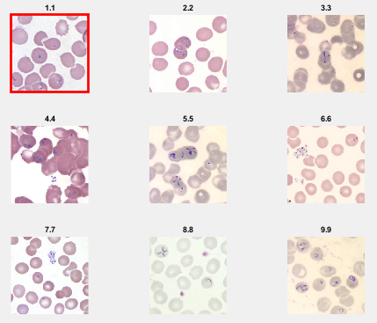
Results
Loading all the images
Selecting a “Target Image”

Slide 12
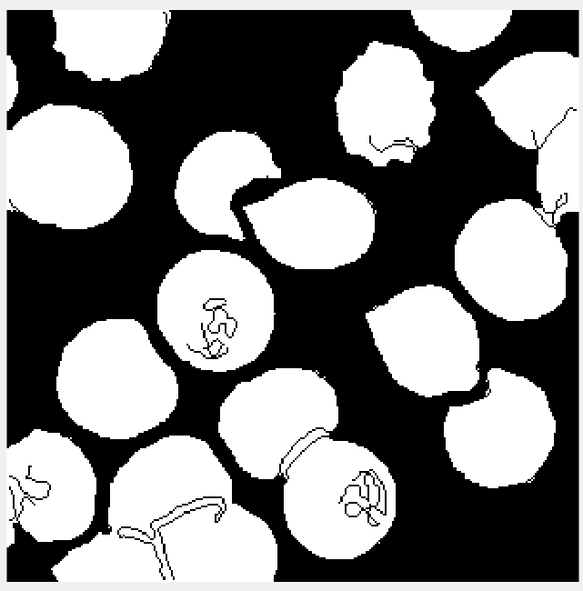
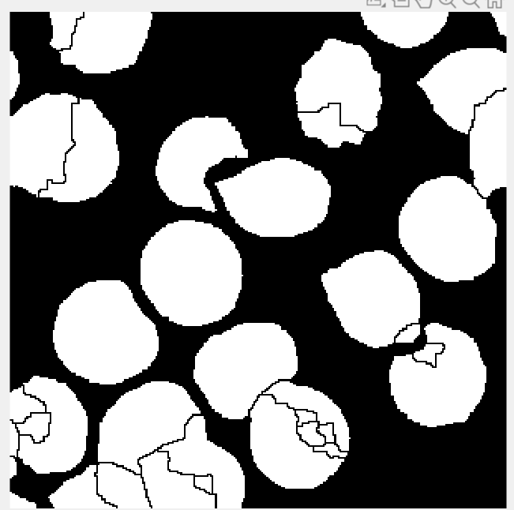
Segmentation Mask
Watershed Segmentation

Slide 13
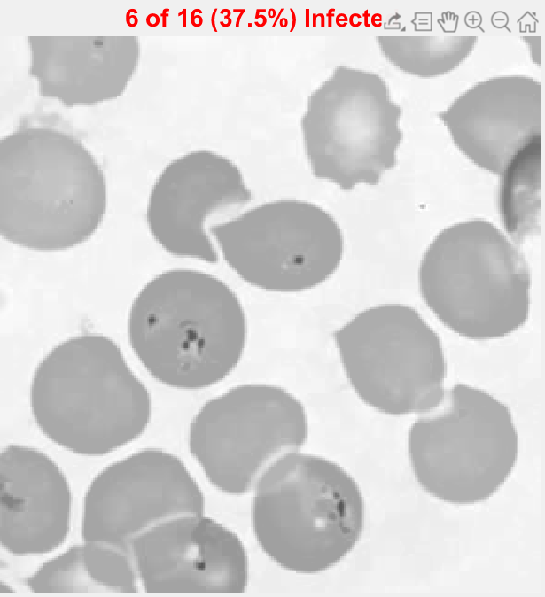
Result on Target Image

Slide 14
Application
To create an automated algorithm to detect percentage of infected cells.
This could be of great use to ease the burden on medical staff who would otherwise manually observe and calculate infections of blood smears

Slide 15
Reference
Blood Smear Malarial Parasite Detection paper by Austin Zheng
https://stacks.stanford.edu/file/druid:yj296hj2790/Zheng_Malarial_Red_Blood_Cell_Counter.pdf
Image Reference:
https://www.cdc.gov/dpdx/babesiosis/index.html
Text Book:
Digital Image Processing Using MATLAB

Slide 16
Thank You

